Slide 1

A PRESENTATION ON
CAR RENTAL
SYSTEM
Prepared by: Subash Gurung, Rikita Gharti, Namrata Bastola, R.A.Mon Tiwari

Slide 2
Designed to streamline the process of renting vehicles to customers.
Efficiently manage a diverse fleet of vehicles, including availability, maintenance schedule, etc.
Implement robust security measures to protect sensitive customer and business data.
INTRODUCTION​

Slide 3

DEVELOPMENT
MS POWERPOINT:
For Presentation slides
ADOBE PHOTOSHOP:
For graphical logos
DISCORD:
For meetings
DRAW.IO:
For Flowchart, DFD, E-r diagram..
MS EXCEL:
For Gantt Chart
VISUAL STUDIO 2022:
For coding
MSQL:
For DATABASE
GitHub:
For Code Sharing

Slide 4
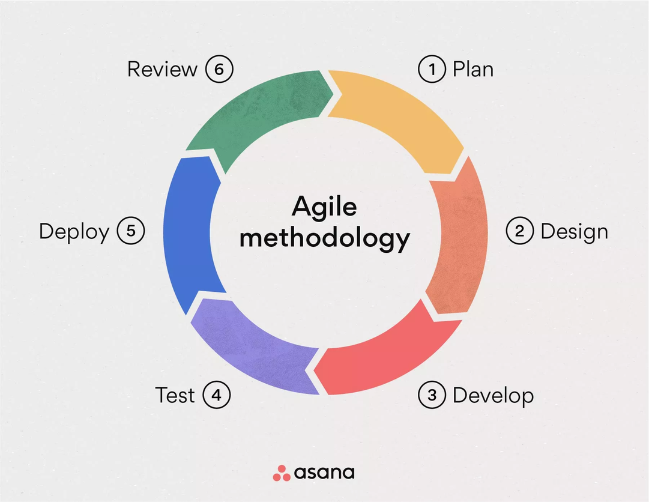
METHODOLOGY
Agile methodologies emphasize iterative development, collaboration, and flexibility in response to changing requirements.
Allows for frequent feedback loops, early delivery of working software, and close collaboration between the coder and documentation team.

Slide 5
METHODOLOGY
The coder can work in short development sprints (e.g., 1-2 weeks) to deliver specific features while the documentation team prepares and updates documentation based on evolving software features.
Use project management tools like Jira or Trello for sprint planning, task tracking, and collaboration.

Slide 6
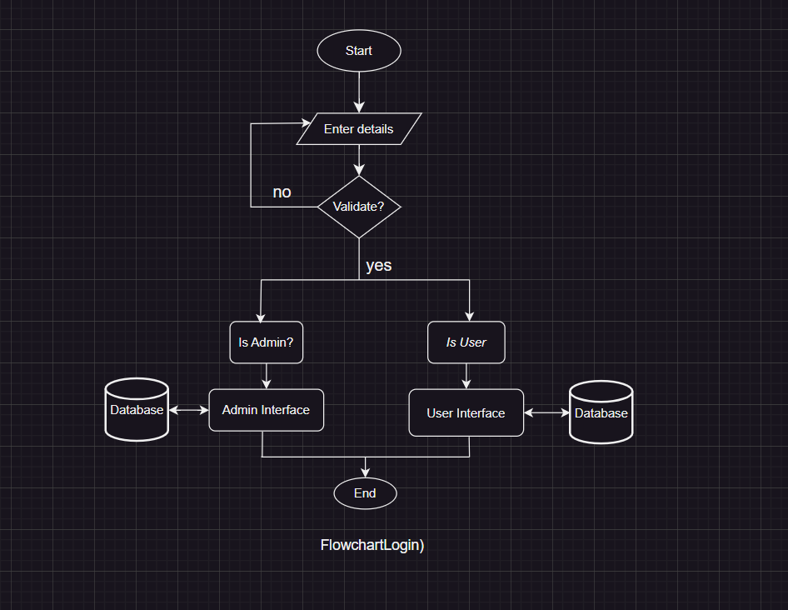
FLOWCHART I:

Slide 7
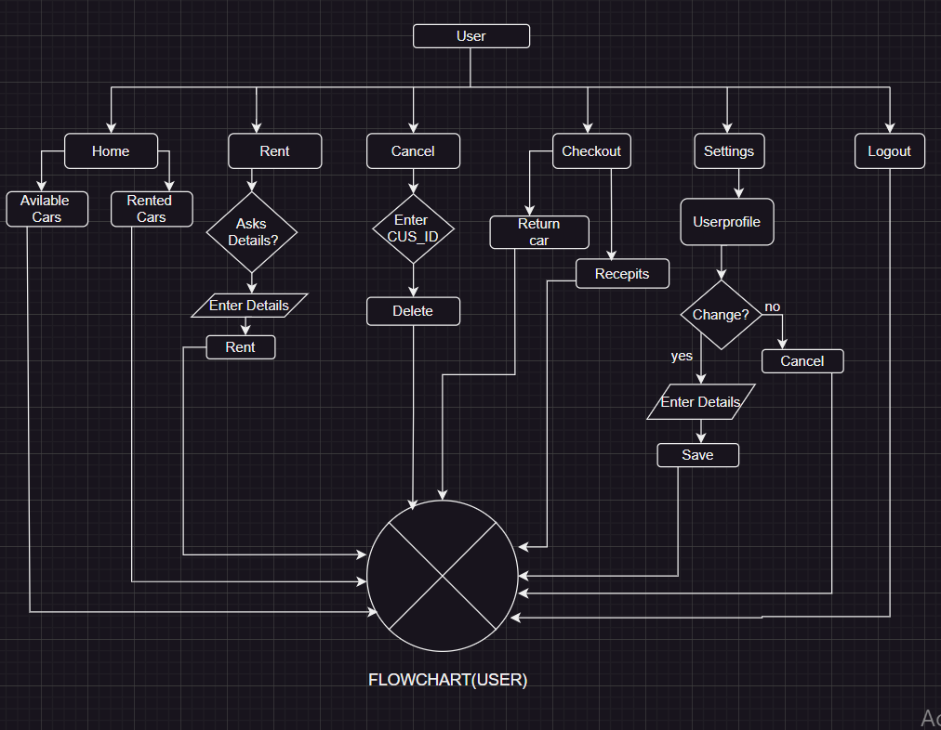
FLOWCHART II:

Slide 8
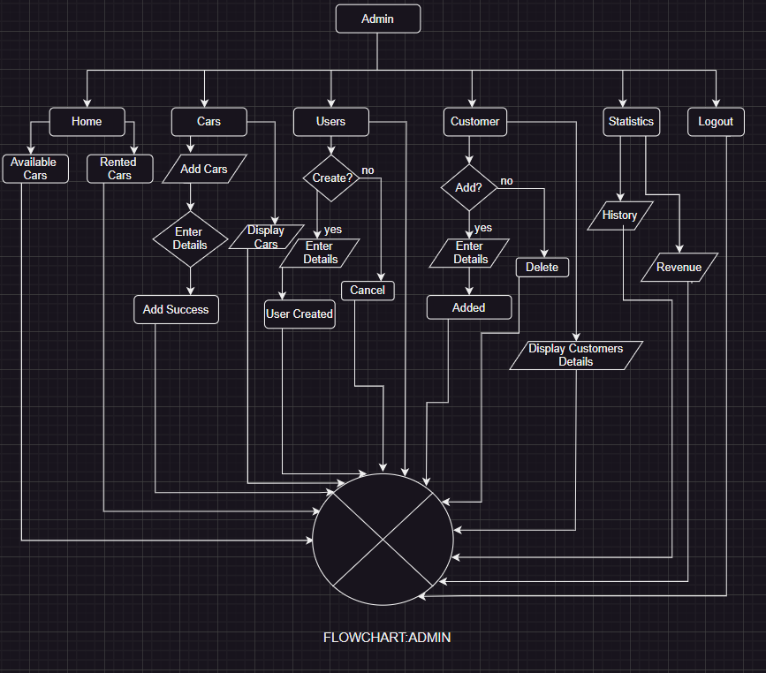
FLOWCHART III:

Slide 9
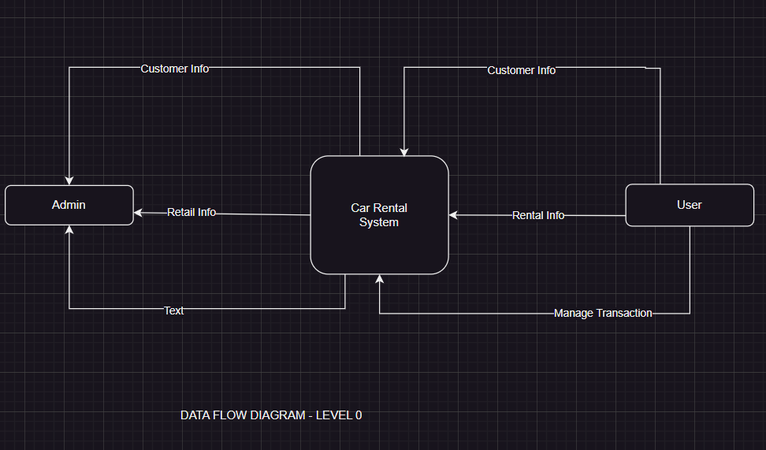
DFD O:

Slide 10
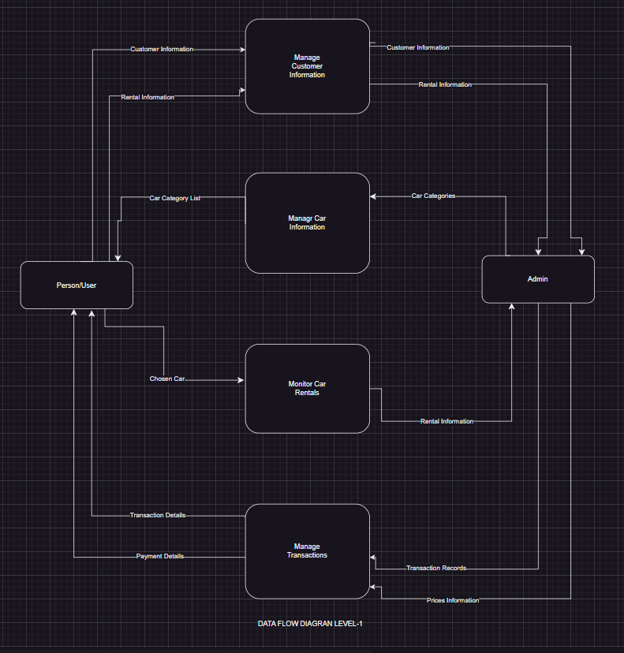
DFD 1:

Slide 11
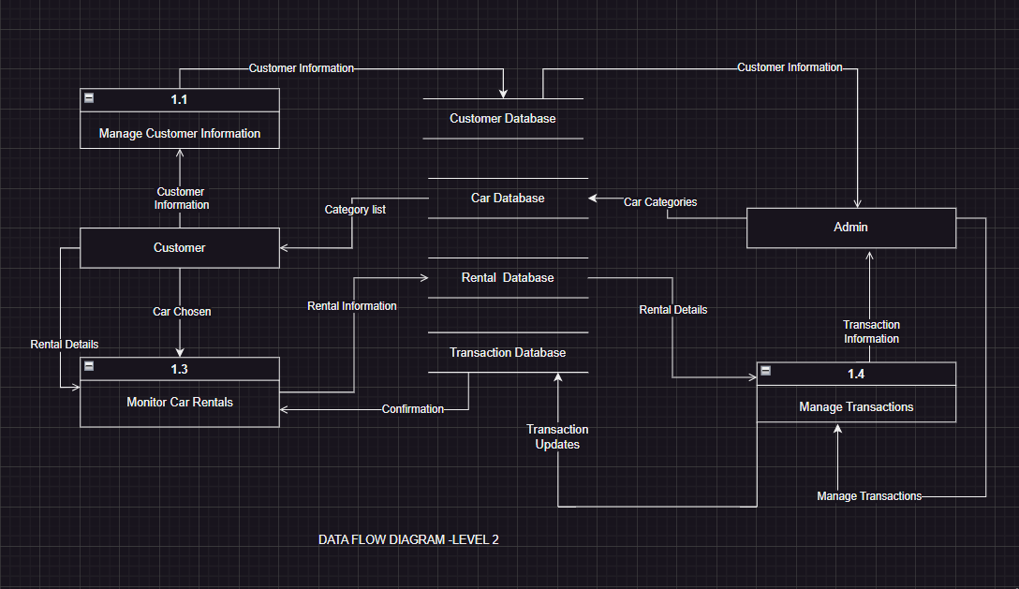
DFD 2:

Slide 12
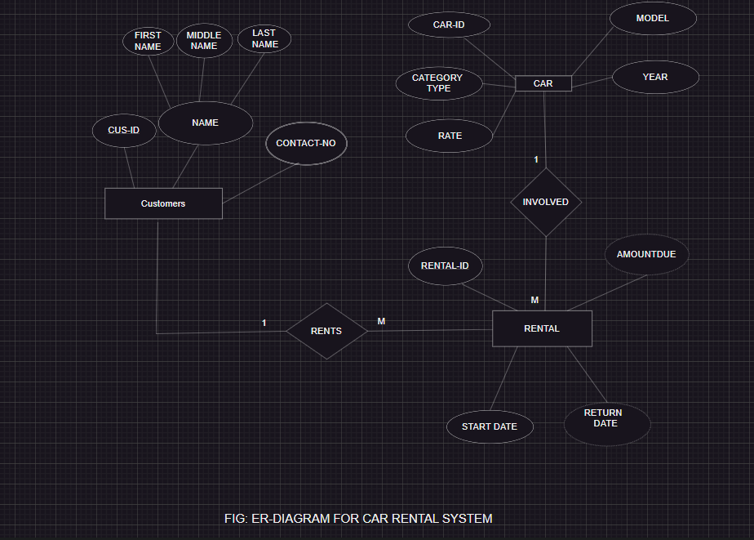
Er-diagram:

Slide 13
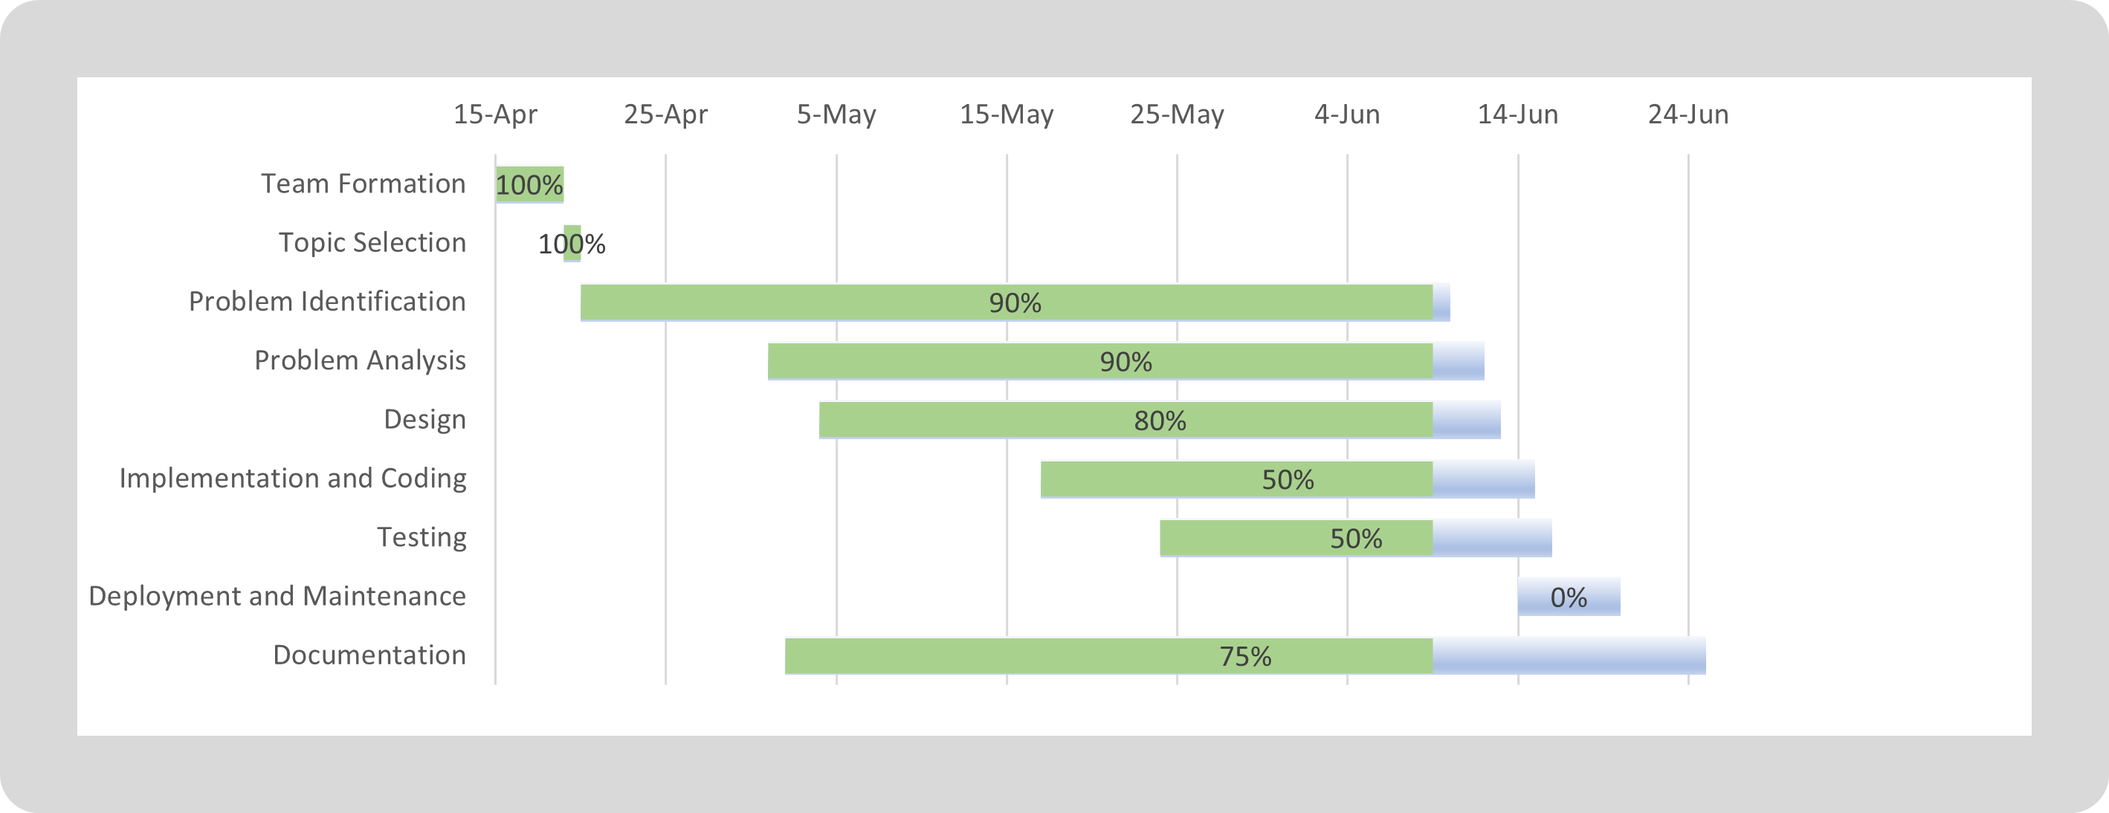
Gantt Chart:

Slide 14
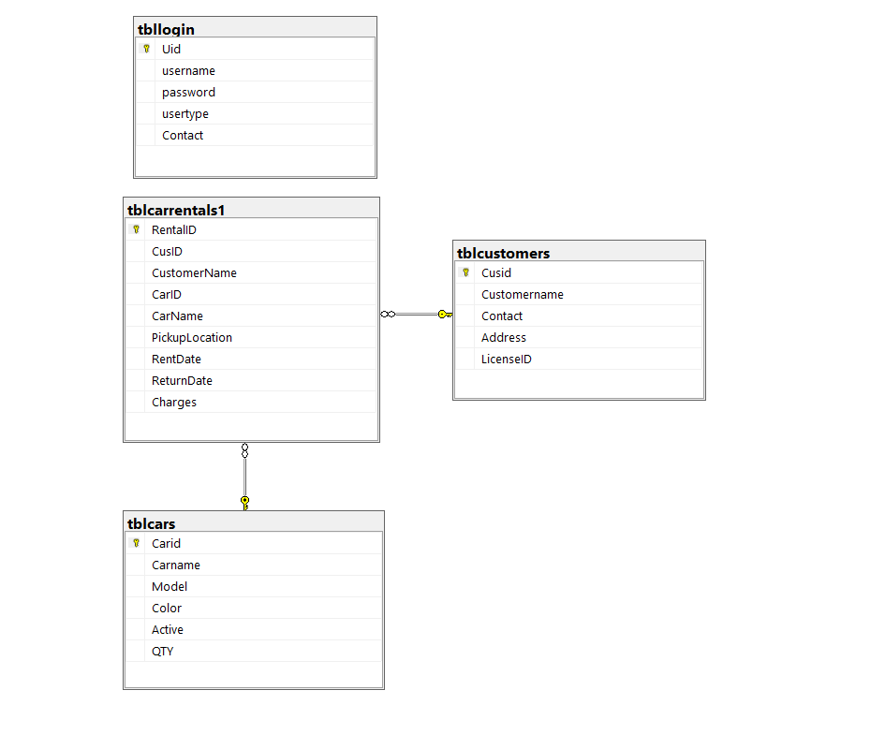
DATABASE SCHEMA:

Slide 15
DEMO

Slide 16
Remaining updates
Update and Delete Operations (CRUD)
Business statistics Option for Admin
Settings Option for User

Slide 17
THANKYOU
WE’RE OPEN FOR Q&A

